Slide 1

Notes:
Chapter 9 Reducing Project Duration
Chapter 9 is devoted to reducing project duration. Project duration reduction is needed for many reasons, such as meeting a customer deadline at the time of project planning or making up the time lost due to delays at the time of project implementation. These situations are common in practice and a part of project manager’s trade-off (cost vs. time) decisions.

Slide 2
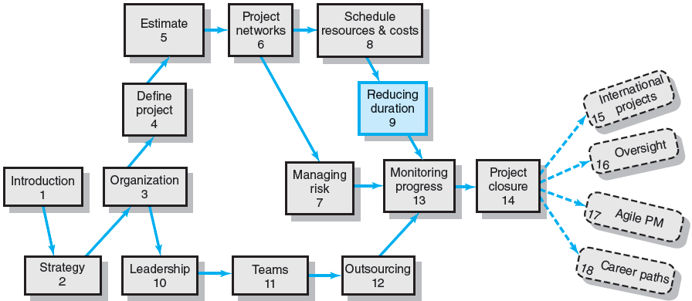
Where We Are Now
Notes:
Where Are We Now?
The need for reducing a project duration occurs during both the project planning and implementation phases. While scheduling a project network, the project manager may consider alternative methods and resources to shorten the project’s duration in order to meet the customer delivery expectation. During the implementation phase, it may be considered again in order to make up time lost to delays, or to meet a new delivery deadline. The effort of reducing a project duration often includes a risk analysis, because a duration reduction usually affects the sensitivity of the project network.

Slide 3
Rationale for Reducing Project Duration
Time Is Money: Cost-Time Tradeoffs
Reducing the time of a critical activity usually incurs additional direct costs.
Cost-time solutions focus on reducing (crashing) activities on the critical path to shorten overall duration of the project.
Reasons for imposed project duration dates:
Time-to-market pressures
Unforeseen delays
Incentive contracts (bonuses for early completion)
Imposed deadlines and contract commitments
Overhead and public goodwill costs
Pressure to move resources to other projects
Notes:
Rationale for project duration reduction
Project duration is a cost factor. During project definition and time estimation, a normal method with economic resources was preferably selected for each work package, to be performed under a normal work condition. Alternative methods and resources however, may exist for some network activities.
In this chapter, alternative methods (and resources) are identified and considered in order to shorten the project duration, possibly at a higher cost. Only critical activities on the project network need to be considered for an alternative, because they affect the project duration. In other words, the (cost-time) trade-off analysis needs to focus only on alternative methods and resources for critical activities. There are many reasons for reducing a project duration, such as:
Deadline, imposed by the customer
Time-to-market, set by a senior manager
Unforeseen delay, in the project implementation phase
Project incentives, such as bonuses for early project completion
Public goodwill, or excessive overhead costs, and
Key resources, to be removed or moved to other projects

Slide 4
Options for Accelerating Project Completion
Resources Not Constrained
Adding resources
Outsourcing project work
Scheduling overtime
Establishing a core project team
Do it twice—fast and then correctly
Resources Constrained
Fast-tracking
Critical-chain
Reducing project scope
Compromise quality
Notes:
Options for speeding up project completion
Many options are available for accelerating project completion. They may be organized into two types: resources constrained and resources not constrained. When resources are NOT constrained, consider using the following options:
add resources
outsource project work
schedule overtime
establish a core project team
do it twice—first do it fast and then do it correctly in the second time
When resources are a constraint, consider using the options of:
fast-tracking, by working on sequential activities concurrently
critical-chain
reduce project scope (or scaling back the project)
compromise quality (using the strategy of design change, special adoption, or acceptance with terms)

Slide 5
Project Direct and Indirect Costs
Project Indirect Costs
Costs that cannot be associated with any particular work package or project activity.
Supervision, administration, consultants, and interest
Costs that vary (increase) with time.
Reducing project time directly reduces indirect costs.
Project Direct Costs
Normal costs that can be assigned directly to a specific work package or project activity.
Labor, materials, equipment, and subcontractors
Crashing activities increases direct costs.
Notes:
Project direct and indirect costs
There are two types of project costs: direct and indirect.
Indirect costs are variable costs that cannot be associated directly with a particular work package or project activity, such as office rental, utilities, consultant fees, and interest on funds borrowed to finance the project. Indirect costs are mostly time-variable costs and could be reduced directly by reducing overall project duration.
Project direct costs are costs that can be assigned directly to a specific work package or project activity such as labor, materials, equipment, and subcontractors. Crashing an activity (with alternative method and resource) usually increase these direct costs.

Slide 6
Reducing Project Duration to Reduce Project Cost
Identifying direct costs to reduce project time
Gather information about direct and indirect costs of specific project durations.
Search critical activities of the lowest direct cost increment (slope) to shorten project duration.
Compute total costs for specific durations and compare to benefits of reducing project time.
Notes:
Collecting project costs for project duration reduction
Collecting costs for project duration reduction consists of the following three steps:
Gather information about direct and indirect costs of each specific project duration.
Search critical activities of lowest cost increment (slope) to shorten project duration.
Compute project total costs for specific durations and making comparisons to the benefits of reducing project time.

Slide 7
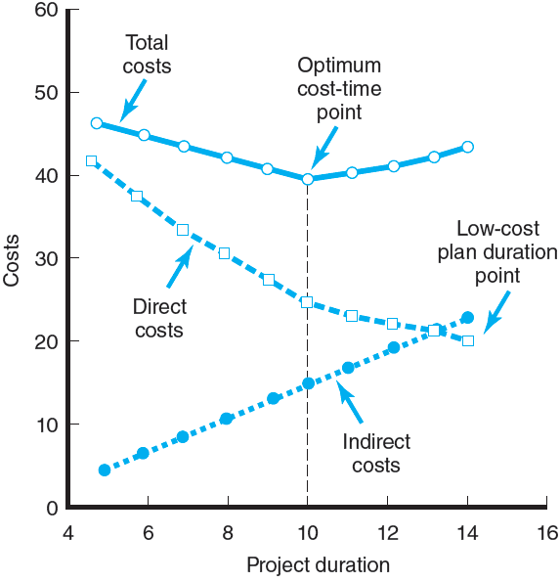
Project Cost–Duration Graph
FIGURE 9.1
Notes:
Project cost-duration graph
Figure 9.1 shows a project cost-duration graph. The top-most curve is the project’s total cost, consisting of two components: direct cost and indirect cost. The indirect cost usually increases with the project duration, at a fixed rate. Direct cost on the other hand, usually decreases along with the duration, as a longer duration allows the use of a normal productive method and resources for each work package in a normal environment and thus usually at a lower cost rate. An optimum project duration is the one at which the total project cost is minimized.

Slide 8
Constructing a Project Cost–Duration Graph
Find total direct costs for selected project durations.
Find total indirect costs for selected project durations.
Sum direct and indirect costs for these selected project durations.
Compare additional cost alternatives for benefits.
Notes:
Constructing a project cost-duration graph
The following four steps are outlined for construction of a project cost-duration graph:
Find total direct costs for selected project durations.
Find total indirect costs for selected project durations.
Sum direct and indirect costs for these selected project durations.
Compare additional cost alternatives for benefits.

Slide 9
Determining activities to shorten
Determining Activities to Shorten
Shorten the activities with the smallest increase in cost per unit of time.
Assumptions:
The cost relationship is linear.
Normal time assumes low-cost, efficient methods to complete the activity.
Crash time represents a limit—the greatest time reduction possible under realistic conditions.
Slope represents a constant cost per unit of time.
All accelerations must occur within the normal and crash times.
Notes:
Determining activities to shorten
The project cost-duration graph is used to determine which activities can be crashed with the smallest cost increment per unit of time, assuming:
The cost-time relationship is linear.
Normal time means a low-cost, efficient method is used to complete the activity.
There is a limit on crash time available (i.e., the greatest time reduction possible under realistic conditions).
The slope represents a fixed rate of cost increment per unit time of reduction.
All time reductions must occur within the normal and crash times.

Slide 10
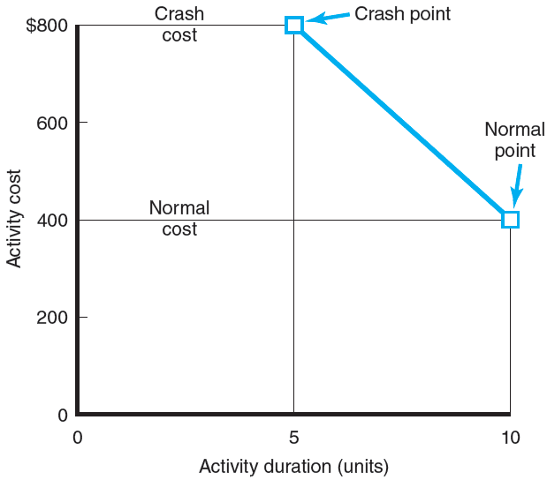
Activity Graph
FIGURE 9.2
Notes:
An activity cost-duration graph
Figure 9.2 shows a cost–duration graph for an activity. With a normal method under a normal condition, the activity needs 10 days and costs $400. With an alternative method for crashing, the activity will take 5 days and cost $800. The line segment connecting the normal point and the crash point is the slope, which is a cost increment rate per day. The slope is $80/day for a total of 5 days for crashing. This cost duration graph needs to be constructed for each project activity.

Slide 11
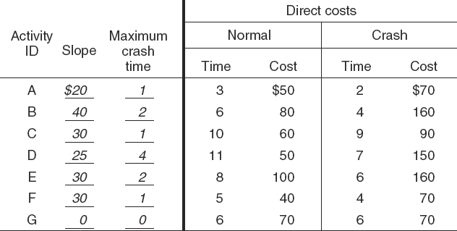
Cost–Duration Trade-off Example
FIGURE 9.3
Notes:
A project cost-duration trade-off example
Figure 9.3 is a cost-duration trade-off chart for a project network of 7 activities, each listed with its normal and crash times and costs. It also lists the slope and time reduction limit for each activity. For example, the activity A will take 3 days and cost $50 under the normal condition. It can be finished in 2 days at $70, when an alternative method is used under a crashing condition. No alternative method or resource exists for activity G and thus its slope and crash time are both 0. Under the normal condition, the project total direct cost is $450.

Slide 12
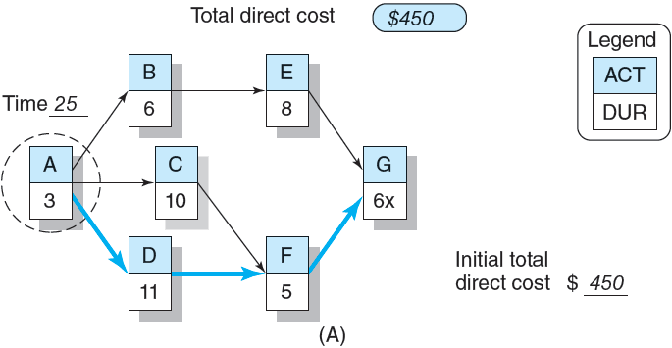
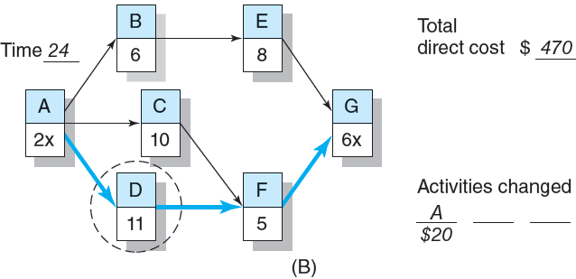
Cost–Duration Trade-off Example (cont’d)
FIGURE 9.3 (cont’d)
Notes:
A project cost-duration trade-off example
Figure 9.3A shows the original project network. The critical path is activities A-D-F-G with a duration of 25 days. Since activity G can’t be shortened, an “x” is used to mark it off from consideration. Activity A is first chosen to shorten the project duration for one day, because it has the least cost increment per day among the three possible candidates. The cost increment is $20. The duration is now cut down to 24 days. The project direct cost is now at $470.
Figure 9.3B reflects the changes discussed above. The duration of activity A is now reduced to 2 days, and an “x” mark is added to the activity, indicating activity A cannot be further reduced. To continue the reduction effort, the network problem is solved again to identify its critical path, which happens to remain the same in this example. Activity D is now chosen to further shorten the project duration for one more day, at $25 of cost increment. Now the project duration will be shortened to 23 days at $495.

Slide 13
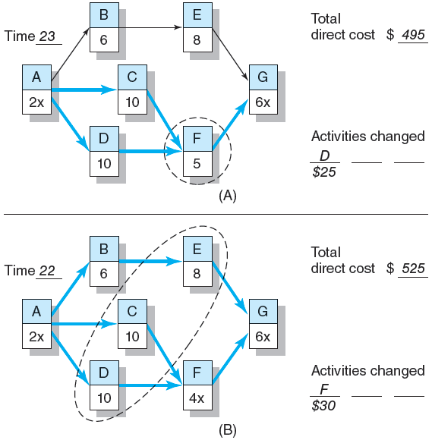
Cost–Duration Trade-off Example (cont’d)
FIGURE 9.4
Notes:
A project cost-duration trade-off example
Figure 9.4A summarizes the changes made above. The network now shows the project has a duration of 23 days with a total direct cost of $495. There are now two critical paths (A-C-F-G and A-D-F-G) on the network. In order to continue reducing the project duration, we need to shorten activity F by one day or both activities C and D by one day. Since F has a smaller cost increment per day, it is chosen to shorten the project duration at a cost of $30.
Figure 9.4B is a resulting network, showing a project duration of 22 days and direct cost of $525. The network also shows that all three paths are now critical, and thus all network activities have become critical. In order to further reduce the project duration to 21 days, each path needs to be shortened by one day. Activities C and D are the only activity available for crashing for the first two paths, respectively. On the third critical path (A-B-E-G), both activities B and E are a candidate for crashing. Between the two, activity E is chosen for its smaller cost increment. By shortening each of activities D, C, and E by one day, the project network duration reduces to 21 days for a total direct cost of $610. The total cost increment is $85 (i.e., $30 + $25 + $30).

Slide 14
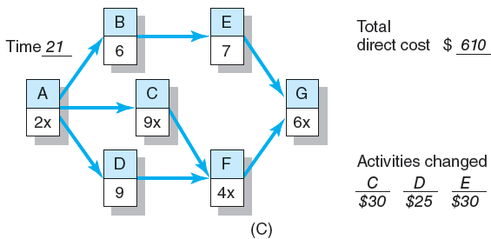
Cost–Duration Trade-off Example (cont’d)
FIGURE 9.4 (cont’d)
Notes:
A project cost-duration trade-off example
Figure 9.4C shows the result of above network changes. It further shows that all project network paths and activities remain critical. The project duration cannot be further reduced, because no activity on the second path can be further shortened. Therefore, the shortest possible duration for this project is 21 days at a project direct cost of $610.

Slide 15
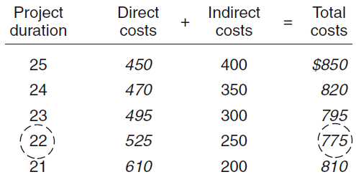
Summary Costs by Duration
FIGURE 9.5
Notes:
Summary of total project costs by duration
After the total direct cost for each project duration is estimated, the next step is to collect the indirect costs for these project durations. Typically the indirect costs are available as a pre-set daily rate, or can be easily obtained from the accounting department. Figure 9.5 presents the total direct cost, total indirect cost, and total project cost for each project duration. Among all feasible project durations, 22 is the best because it has the least total project cost.

Slide 16
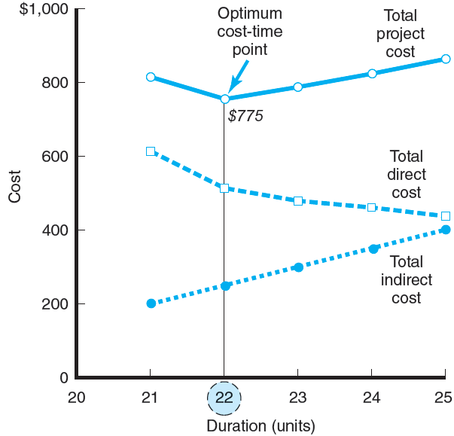
Project Cost–Duration Graph
FIGURE 9.6
Notes:
Project cost-duration graph
Figure 9.6 is a project cost-duration graph over its duration interval of 20-25. The graph shows that the optimum cost-time duration is 22 days at a total project cost of $775. Moving away from this duration in either direction will increase the project’s total costs.

Slide 17
What if Cost, Not Time Is the Issue?
Commonly Used Options for Cutting Costs
Reducing project scope
Having owner take on more responsibility
Outsourcing project activities or even the entire project
Brainstorming cost savings options
Notes:
What if cost, not time, is the issue?
When the total project cost is the dominating issue, the following actions should be considered to cut project costs:
Reduce project scope to deliver less than originally planned
Have the owner (or customer) take on more responsibility for some project activities. For example, the owner may be willing to participate in technical documentation and developing a user’s manual.
Outsourcing some project activities or even the entire project, if a subcontractor is available to lower the cost.
Brainstorming to develop ideas and options for cost savings

Slide 18
Key Terms
Crashing
Crash point
Crash time
Direct costs
Fast-tracking
Indirect costs
Outsourcing
Project cost–duration graph
Notes:
Key terms
Below are key terminology and concepts covered in this chapter.
Crashing is the shortening an activity or project.
Crash point is the most a project activity time can realistically be compressed with the resources available to the organization.
Crash time is the shortest time an activity can be completed (assuming a reasonable level of resources).
Direct costs are costs that are clearly charged to a specific work package—usually labor, materials, or equipment.
Indirect costs are costs that cannot be traced to a particular project or work package.
Fast-tracking accelerates project completion typically by rearranging the network schedule and using start-to-start lags.
Outsourcing involves contracting for the use of external sources (skills) to assist in implementing a project.
Project cost–duration graph plots project cost against time; it includes direct, indirect, and total cost for a project over a relevant range of time.

